Slide 1
CLIMATE CHANGE PROJECT

Slide 2
Explanation of the Project
The aim of this project is to collect and analyze a dataset that can demonstrate change in climate conditions over the last century.
The data used in this project was obtained from https://ourworldindata.org/climate-change

Slide 3
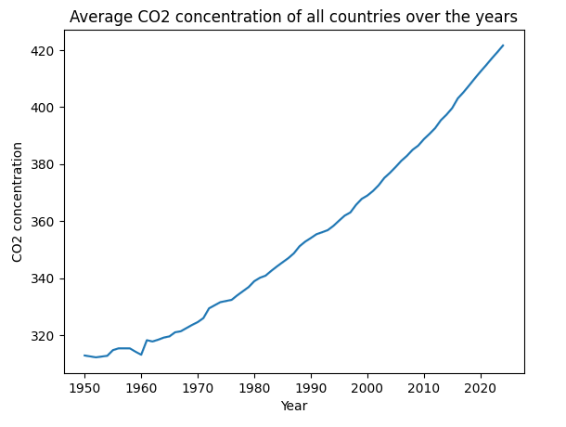
Change In CO2 Levels Between 1950-2020
CO2 levels have increased almost linearly between 1950-2020.

Slide 4
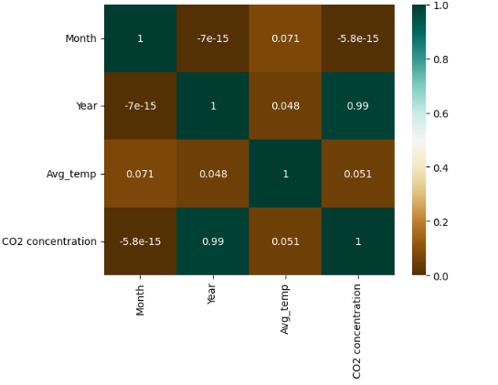
Correlation between various features
A correlation heatmap is plotted between various features in the dataset.
The heatmap shows a direct relation between CO2 concentration and the Average temperature.
The correlation coefficient between CO2 concentration and Average temperature is 0.051.

Slide 5
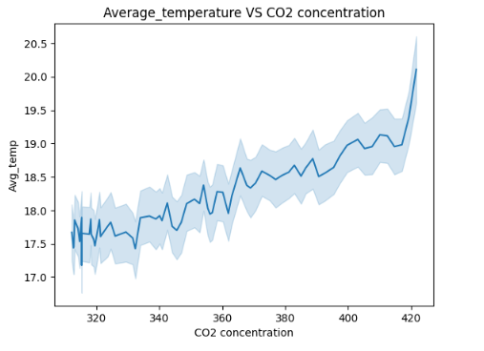
Relation between Average temperature and CO2 concentration
From the plot it can be clearly seen that the average temperature increases with increase in CO2 concentration

Slide 6
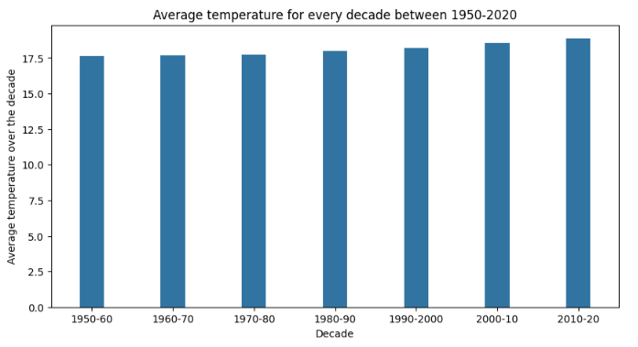
Temperature changes over the decades
The average temperature was calculated for each decade since 1950.
The average temperatures since 1950 have increased steadily.

Slide 7
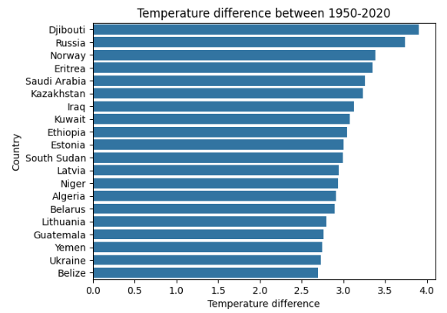
Increase in Average Temperatures For Various Countries between 1950-2020
Every country has had an increase in the average temperature since 1950.
Djibouti has had the highest increase in average temperature between this period.

Slide 8
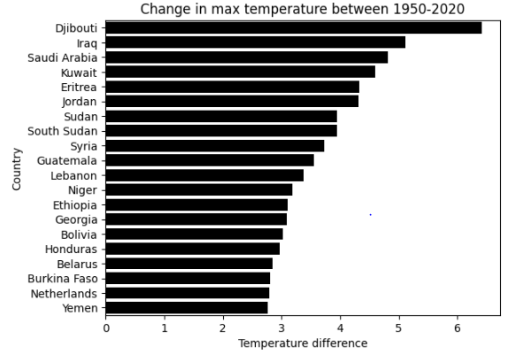
Changes in maximum temperatures for various countries since 1950
Most countries have had an increase in their max temperatures.
170 countries have had an increase in their max temperatures.
25 countries have had a decrease in their max temperatures.
Djibouti has had the highest increase in max temperature between 1950-2020 of approximately 6.5 degree Celsius.

Slide 9
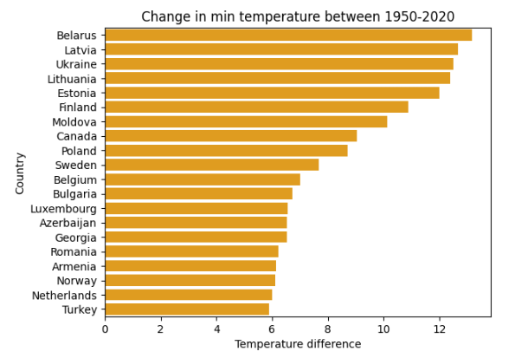
Changes in minimum temperatures for various countries since 1950
Most countries have had an increase in their max temperatures.
183 countries have had an increase in their min temperatures.
12 countries have had a decrease in their min temperatures.
Belarus has the highest increase in minimum temperature between 1950-2020 of approximately 13 degree Celsius

Slide 10
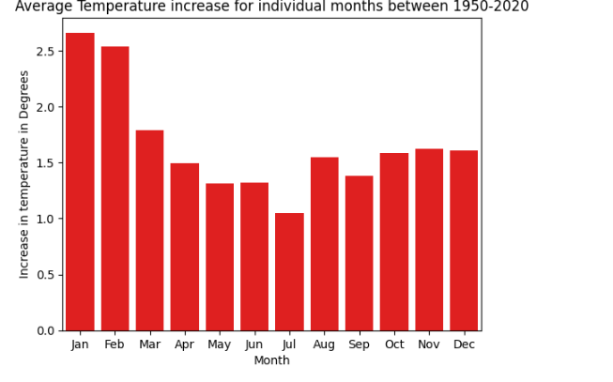
Increase in Average monthly temperatures since 1950
The average temperature has increased for all the months.
The summers have gotten hotter and the winters less cooler.
The month of January has had the highest increase in average temperature.
The month of July has had the least increase in average temperature .

Slide 11
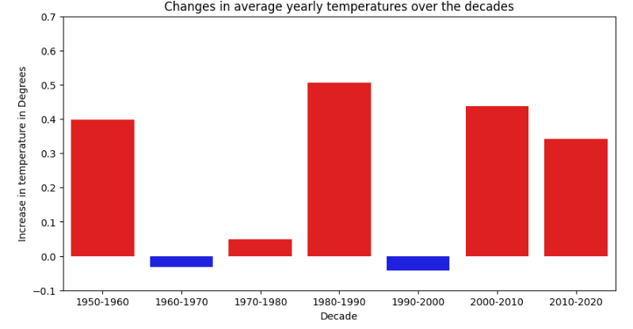
Changes in average temperatures between decades since 1950
The decade of 1980-1990 had the highest increase in the average temperature.
The decades of 1960-1970 and 1990-2000 had a slight decrease in the average temperature

Slide 12
Conclusions
Co2 levels have increased almost linearly between 1950-2020.
The average temperatures since 1950 have increased steadily.
The above plot shows a direct relation between average temperature and CO2 concentration.
Higher CO2 concentrations lead to higher temperatures.
The average temperature has increased for all the months.
The summers have gotten hotter and the winters less cooler. 10).The month of July has had the least increase in average temperature between 1950-2020.
Most countries have had an increase in their max temperatures.
170 countries have had an increase in their max temperatures and 25 countries have had a decrease in their max temperatures. 17).Most countries have had an increase in their min temperatures.
183 countries have had an increase in their min temperatures and 12 countries have had a decrease in their min temperatures.

Slide 13
Thank You

